Slide 1


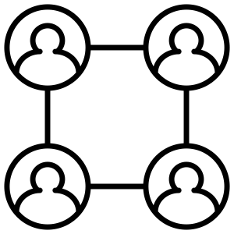
What can we deliver without adding operational complexity?
After user testing and synthesis, list out the questions you have around feasibility and engage the relevant (external/internal) stakeholders to find out the answers. Think about who is integral to the delivery of your offer, who you would need to engage to support/deliver new developments, or who might be a blocker.
It’s key that you continuously consider how to deliver the most desirable ideas or features without adding operational complexity and think about wider considerations for delivery e.g. supply chain or cost of fulfilment. By engaging people early on you can anticipate challenges/barriers and design around them.
Who internally/externally is integral to the delivery of this fundraising offer or the potential new developments? Who do we need to consult?
What suppliers should you engage to understand cost implications and impact on ease of delivery (cost, timelines, data etc.)?
What internal teams should you engage? E.g. Philanthropy to identify synergies, opportunities to leverage existing activities / assets in other parts of Amnesty to avoid duplication

