Slide 1
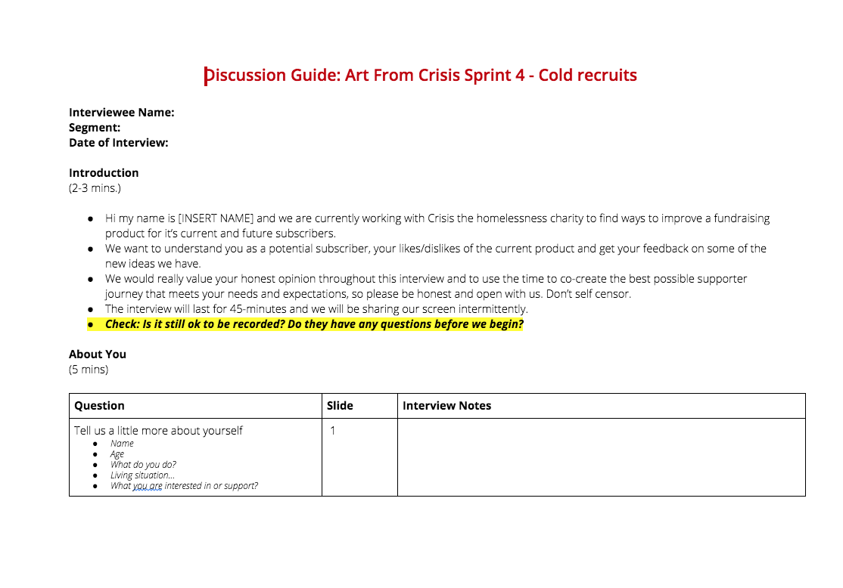
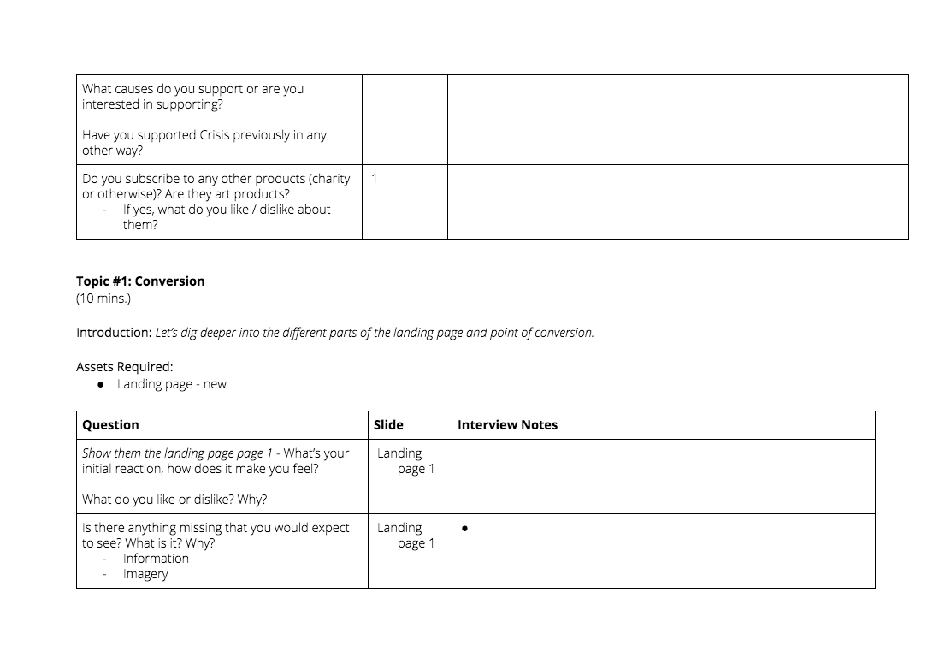
TOP TIPS for user testing interviews
Open questions and long pauses are good
Ask lots of questions but make sure they’re not leading
Give your interviewee plenty of time to speak and listen carefully, especially after long pauses
Even if your questions seem obvious or stupid, it’s important to get all the feedback you need using the stimulus you’re testing. Ask them in multiple ways. And remember not to give your opinion.
Focus on ‘the why’...
Think about the ‘pyramid flow’
Make note of questions that don’t work and build different guides for different audiences
Collecting facts is not that useful - focus on the motivations, wants, needs and emotional drivers. (Sometimes the functional drivers are also important!)
Start broad and narrow as you go, e.g.:
Explore their needs around a product > prioritise needs or desired features > gt feedback on specific ideas
> ask for suggestions on how to improve it
Cold and warm audiences will require different questions, even if you’re using the same stimulus. Capturing what doesn’t work will help you evolve the discussion guide as you interview.

