Slide 1
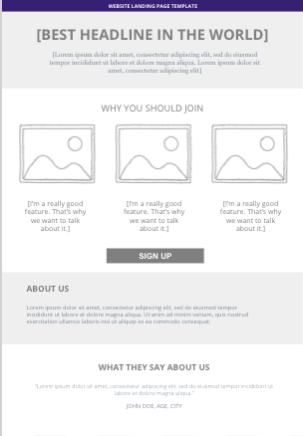
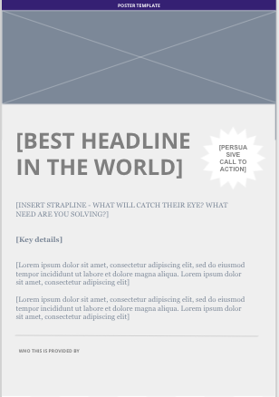
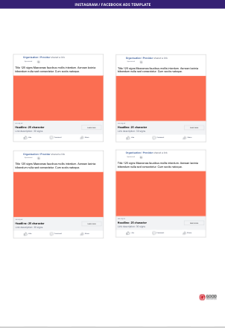
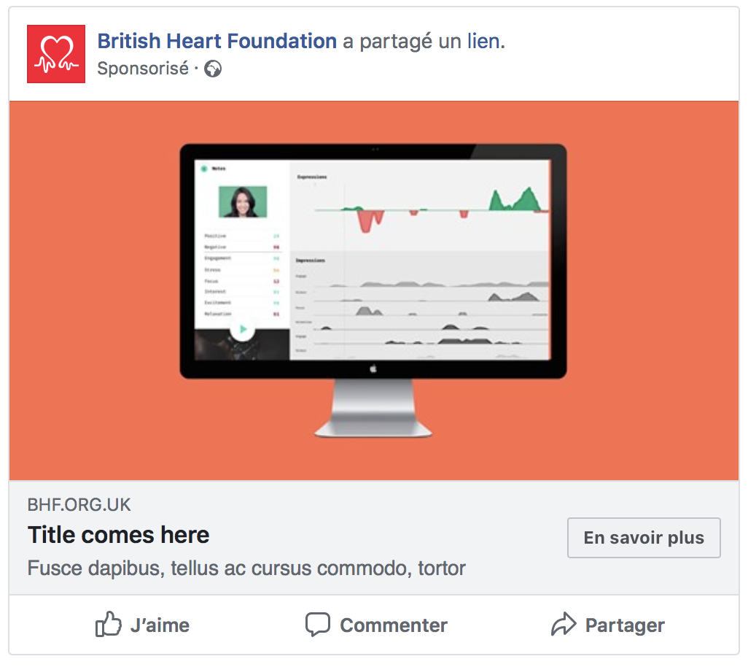

Prototypes can take different forms so be sure to select which format is most appropriate
Amnesty International shared a link
Sponsored
Title 125 signs Maecenas faucibus mollis interdum. Aenean lacinia bibendum nulla sed consectetur. Cum sociis natoque.
AMNESTY.ORG.UK
Learn more
Headline: 25 character
Link description: 30 signs
Like
Comment
Share

Slide 2
Remember the stimulus doesn’t have to be perfect and completely designed - it’s the minimum you need to put in front of a user to elicit a reaction so focus on the bits you need to test or get answers to!
1
For example, you might isolate a specific section of the landing page and A/B test it to identify which version tests better with users.
2

