Slide 1



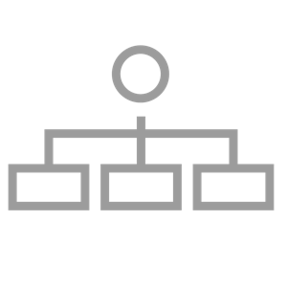
How will I prioritise ideas to test?
Prioritise your ideas using assumptions or existing data from all 3 lenses:
You think the audience will want it
You think the organisation will be able to deliver it, or can do so with few adjustments
You think the idea will improve profitability / market position / has a viable business model or case
Desirable
Viable
Feasible

