Slide 1
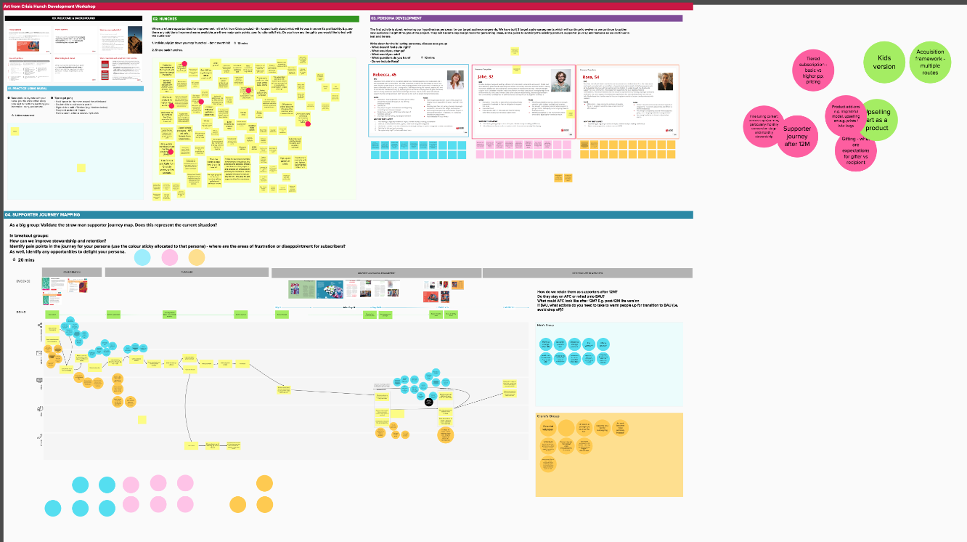
What happens after the hunch development workshop?
You’ll leave the session with a long-list of thought-starters and hunches. At first, it may seem like a chaotic mess, but don’t fear!
Your follow up task will be to clean up the ideas - combine duplicates and combine similar ideas into clusters .

