Slide 1
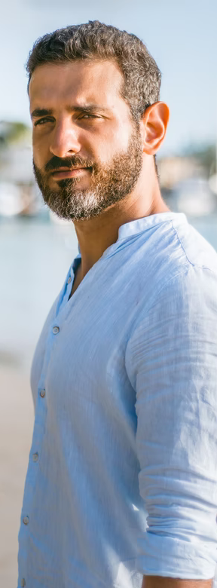



3: Persona Example
Who is my audience?
BIO
“I’m still looking for those experiences I enjoyed when I was in my 20s.
“
He attended lots of music festivals in his late teens and twenties, but goes a lot less now he has a family.
Dan is 35, has 2 kids aged 3 and 5 and his wife Georgie works part time as a solicitor. They live in the country now but met at university when they attended lots of festivals.
They are always looking for experiences they can do together as a family, but it’s not always easy to find things that the kids and adults like equally. They like to do things that create memories and quality family time, they like going to places like the science museum, weekends away to different parts of the UK, and music festivals.
He’s doesn’t donate or fundraise for Amnesty but it’s a cause he believes strongly in. He has fond memories of Amnesty from the times at school when we’d write Amnesty letters at school. He also wants the kids to learn more about human rights, equality and fairness.
“
Gains
Pains
Capturing his formative years but in a way that makes sense to his life now
Sharing new experiences with his family that break the norm
Introducing his children to culture, music and festivals
Making memories
Being the cool dad
Finding the balance between having fun and caring for his children
Holding back and feeling like festivals just aren’t the same anymore
Juggling the extra responsibilities and difficulties of taking kids to festivals
Limited to child friendly festivals and experiences
DAN IN DENIAL
Influences
· FAMILY
· MUSIC
· TECHNOLOGY
35, Yorkshire
Solicitor
^{· STATUS}
^{Married with kids}
^{· SALARY}
^{High}
Frequently used apps
· SPOTIFY
· INSTAGRAM
· FESTICKET
xxx

